Slide 1

Global Spatial Distribution Of
Open-Source
Artificial Intelligence
MACS 30112
Winter 25
Final Project
Anqi Wei, Baihui Wang, Charlotte Li

Slide 2

Guidelines
MACS 30112
01 Introduction
05 Data Wrangling
02 Data Collection
Winter 25
06 Data Analysis
03 Data Cleaning
07 Conclusion
04 Data Visualization
Final Project

Slide 3
Introduction
MACS 30112
Winter 25
Topic Description, Research Question & Hypothesis
Final Project

Slide 4
Introduction
Significance:
Democratizing AI innovation vs. persistent geographic inequality.
Policy implications for equitable technological access.
MACS 30112
Key Focus:
Analyze global spatial patterns of open-source AI development.
Explore socioeconomic drivers (GDP, education, scholar publication).
Description of Topic
Winter 25
Final Project

Slide 5
Introduction - Research Question
MACS 30112
RQ1: Which cities/countries dominate AI-related open-source projects?
RQ2: How do economic development and higher education explain these patterns?
Winter 25
Final Project

Slide 6


Hypothesis
MACS 30112
H1: Higher GDP density ➔ Higher open-source AI activity.
Winter 25
H2: Strong AI publication presence ➔ Reinforces open-source contributions.
Final Project

Slide 7
Data Collection
MACS 30112
Winter 25
Data Sources, Data Collection & Scraping
Final Project

Slide 8
Data Collection
Data Sources
MACS 30112
Source | Description
GitHub | Top 270 AI repositories (star-based ranking); 11,256 contributors’ locations.
World Bank | GDP & GDP per capita (2023)
UNESCO GERD | R&D Investment as % of GDP (proxy for innovation capacity).
UN Population Data | City/country population metrics for per capita calculations.
Our World in Data | Annual AI Publications for tracking AI research output.
Winter 25
Final Project

Slide 9
Data Collection & Scraping
MACS 30112
GitHub Workflow:
Scraped AI repositories using Python (pagination + token rotation to bypass API limits).
Extracted metadata: stars, contributors, commit frequency, geolocations.
Geocoding:
OpenStreetMap + Google Maps APIs to standardize city/country names.
Handled multilingual entries via Google Translate API (with manual validation).
Winter 25
Final Project

Slide 10
Data cleaning n Visualization
MACS 30112
Winter 25
Baihui Wang
Final Project

Slide 11
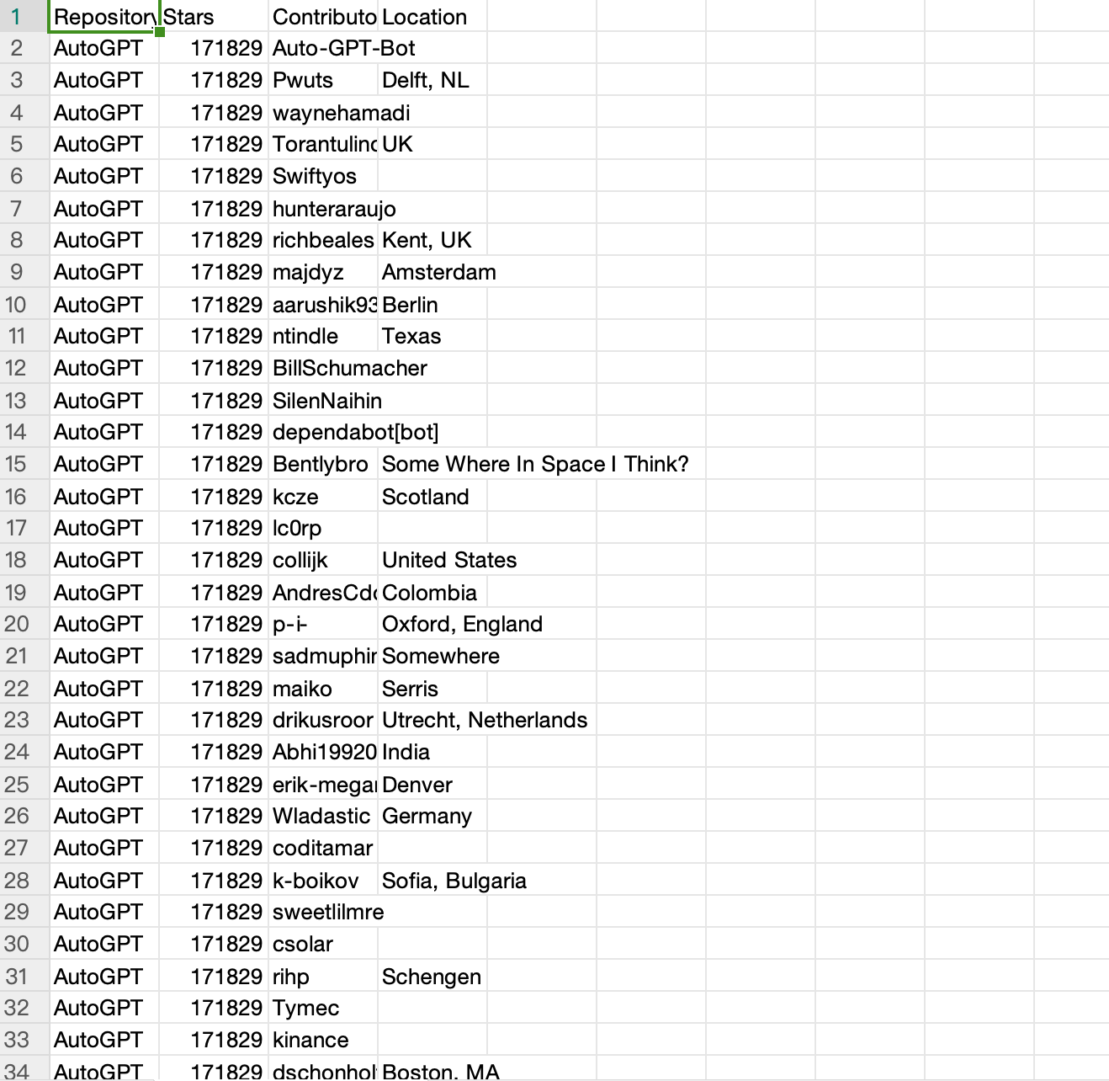



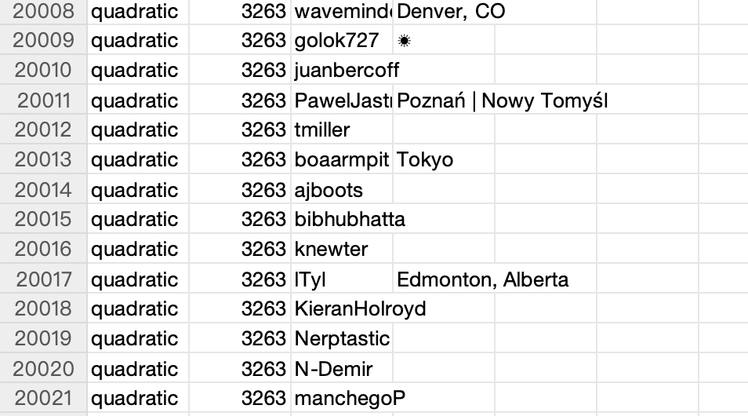




Initial Data
MACS 30112
GROUP A
Winter 25
GROUP C
Final Project

Slide 12
MACS 30112
Data
Cleaning
Winter 25
Final Project

Slide 13
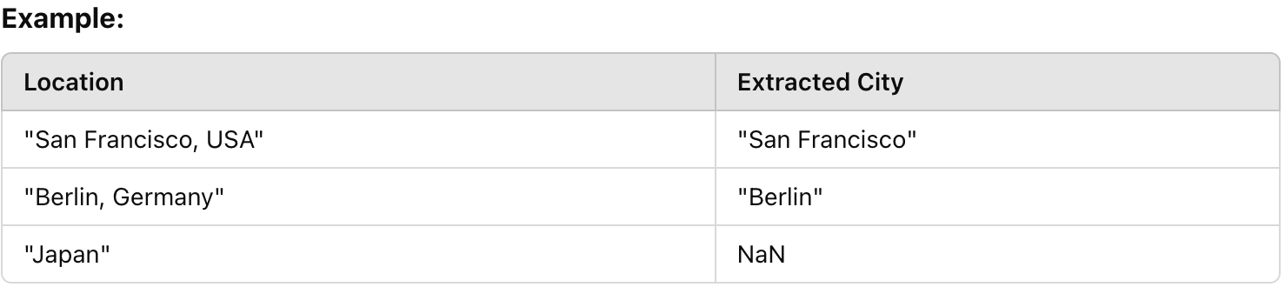
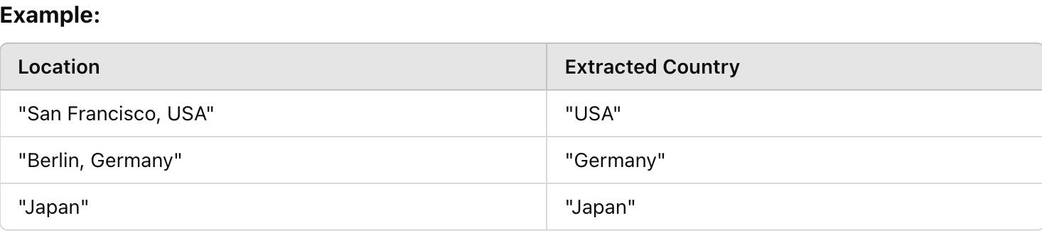
Extract cities from locations:
MACS 30112
Extract countries from locations:
Winter 25
Final Project

Slide 14
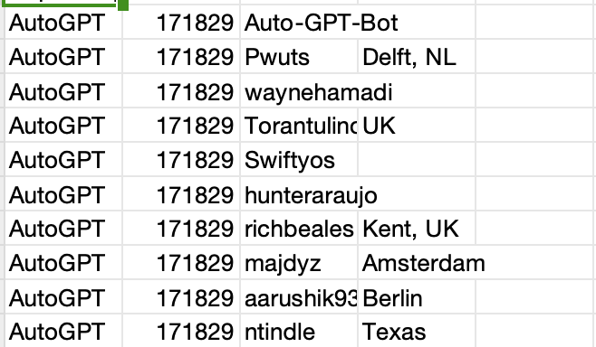
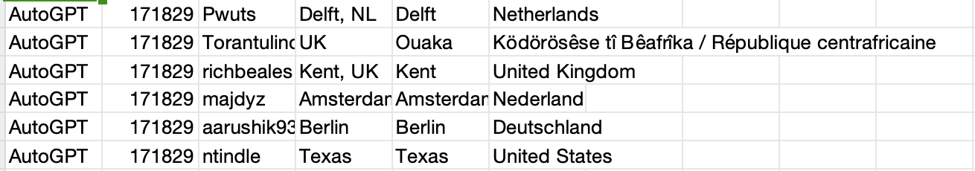
MACS 30112
Winter 25
Final Project

Slide 15

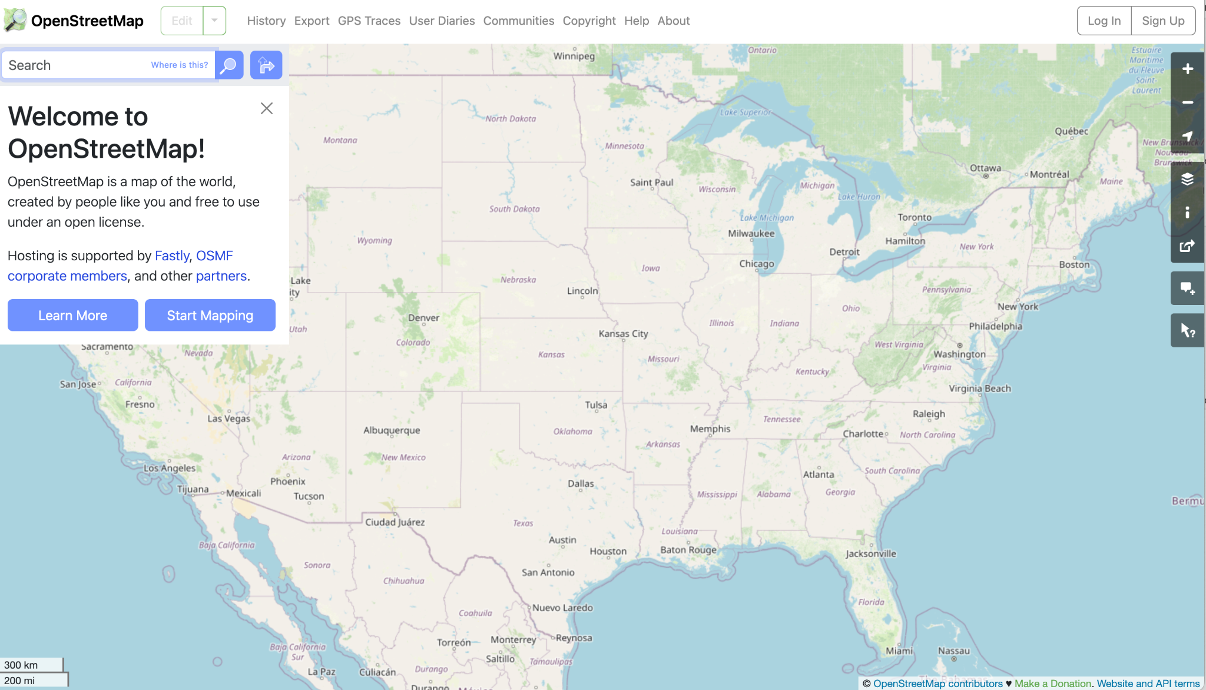
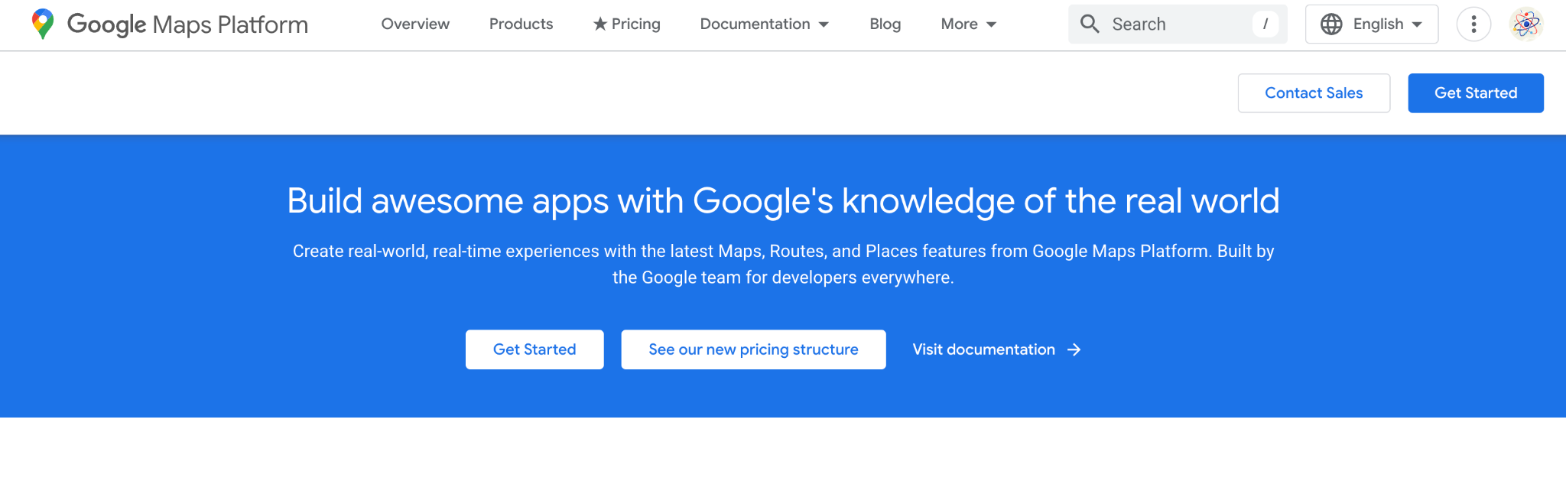
Geocoding—handle partial location input
MACS 30112
Winter 25
Final Project

Slide 16
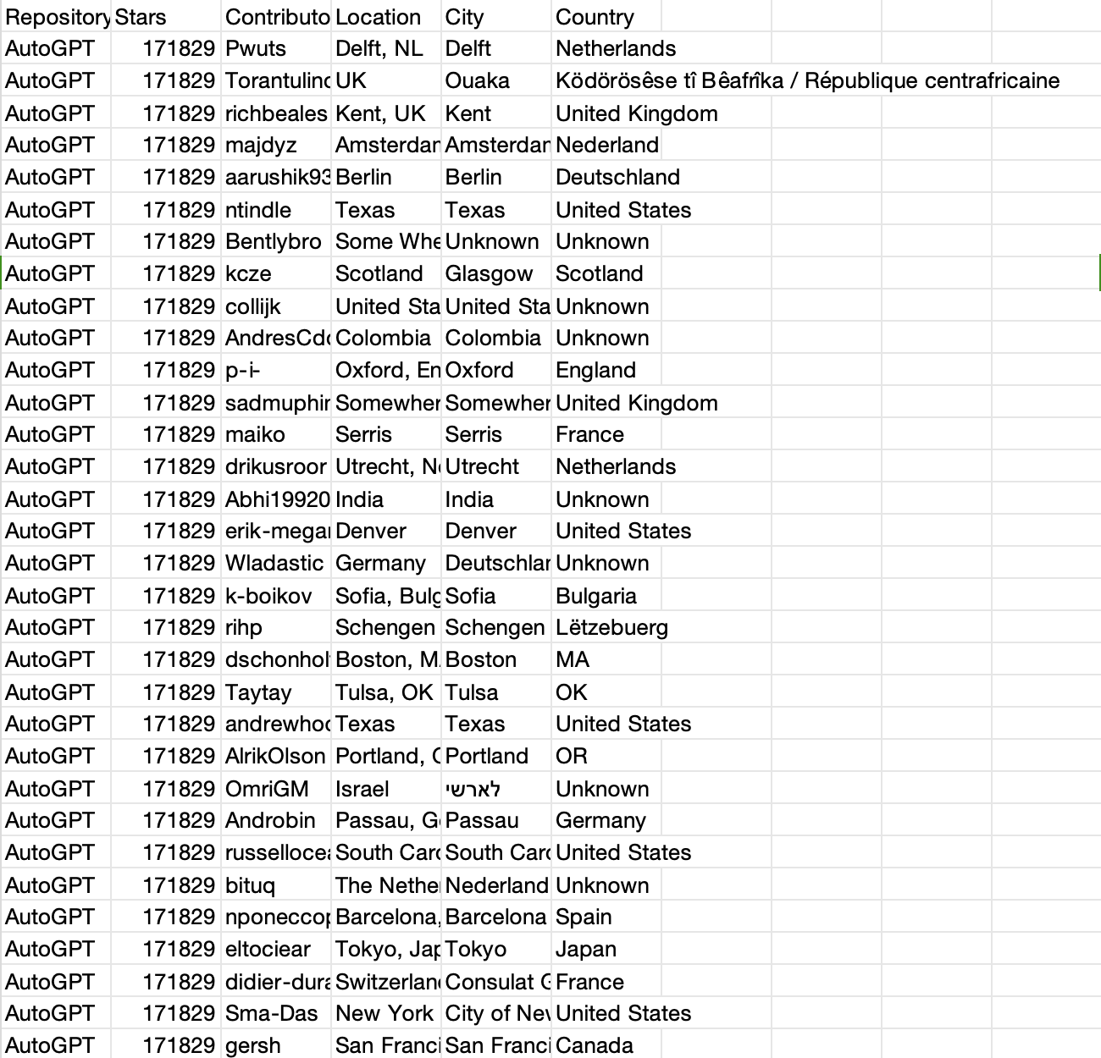

Geocoding—
handle partial location input
First-time geocoded data
Group A
Group B
MACS 30112
NAME HERE
Winter 25
NAME HERE
NAME HERE
Lessons Learned & Optimization
NAME HERE
Final Project
NAME HERE
NAME HERE
NAME HERE

Slide 17
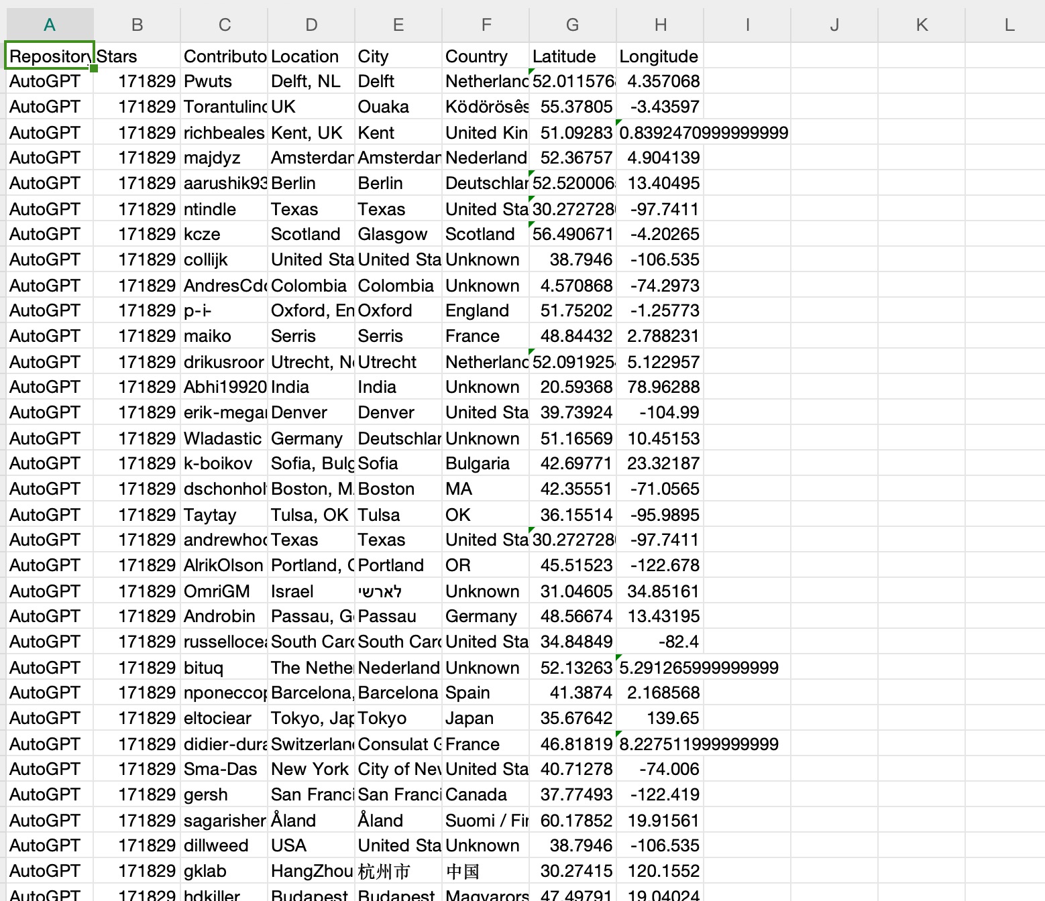
Second-time geocoded data
MACS 30112
Using batch geocoding significantly increases the efficiency and reduces processing time
Winter 25
Lessons Learned & Optimization
Final Project

Slide 18
MACS 30112
Interactive Mapping & Insights
Winter 25
https://github.com/macs30112-winter25/final-project-chick-fil-a/blob/main/Data%20Visualization/top_1000_contributors_map.html
Final Project

Slide 19
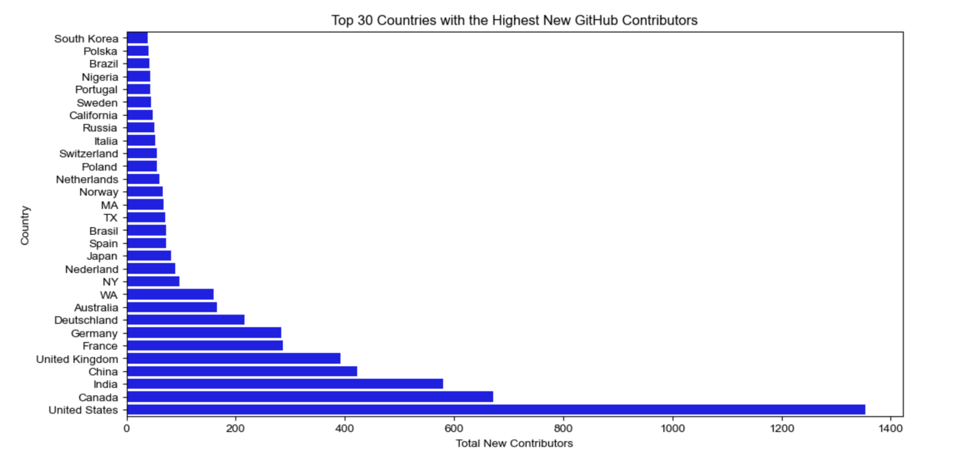
Further Analysis
MACS 30112
Winter 25
Final Project

Slide 20
Data
MACS 30112
Winter 25
Wrangling
Final Project

Slide 21
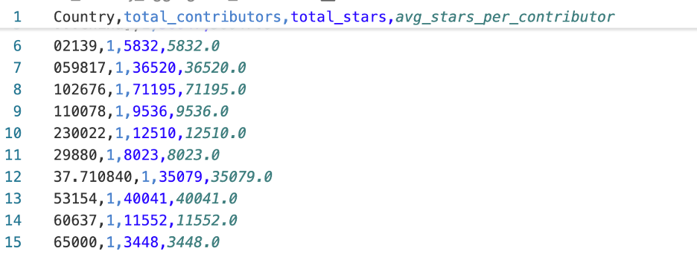
Typical errors
MACS 30112
Winter 25
containing numbers or symbols instead of actual country names
.
Final Project

Slide 22
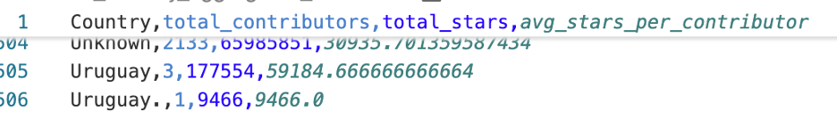
Typical errors
MACS 30112
Winter 25
2. Country names failing to merge correctly due to extra symbols…
Final Project

Slide 23
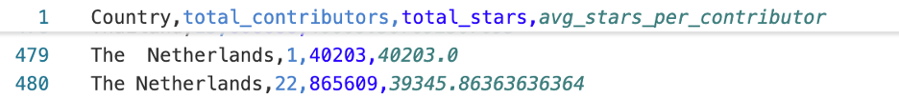
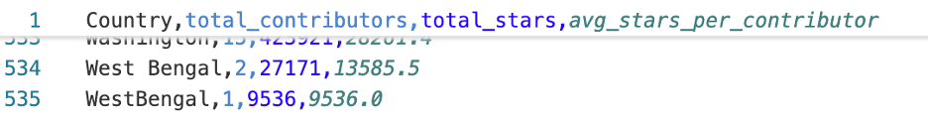
MACS 30112
Winter 25
Typical errors
2. Country names failing to merge correctly due to extra symbols
Or multiple spaces…
Final Project

Slide 24
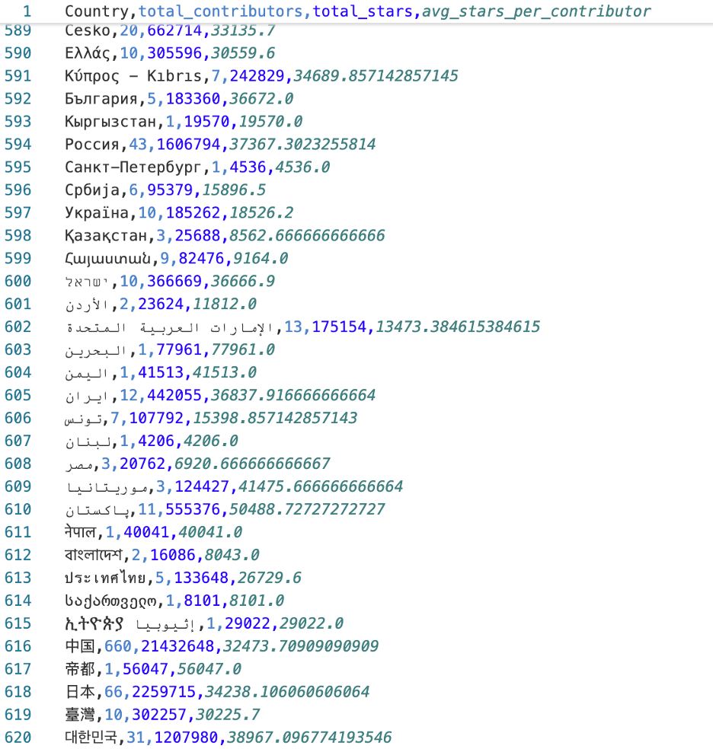
MACS 30112
Typical errors
Winter 25
3. Country names appearing in different languages.
Final Project

Slide 25
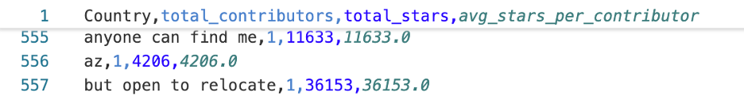
Typical errors
MACS 30112
Winter 25
4. Or, some naughty (misleading) words from user
Final Project

Slide 26

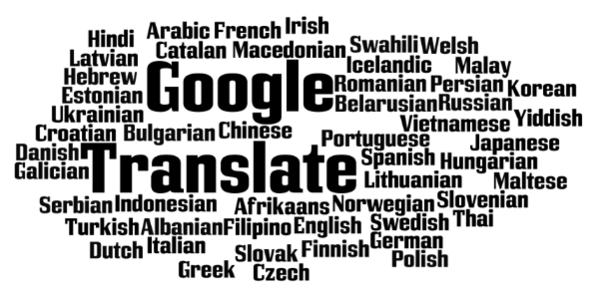

Regular Expressions;
Google Translator;
Pycountry;
high-threshold fuzzy matching;
Manual verification
MACS 30112
Winter 25
Final Project

Slide 27
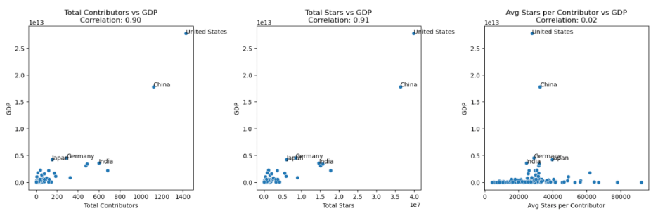
Oue new dataframe included:
GDP per capita (2023);
R&D Investment Index;
——national investment into research and development
Annual AI Publications
MACS 30112
Winter 25
Final Project
the United States, China, Germany, Japan, and India stood out as leading countries in AI open-source development

Slide 28
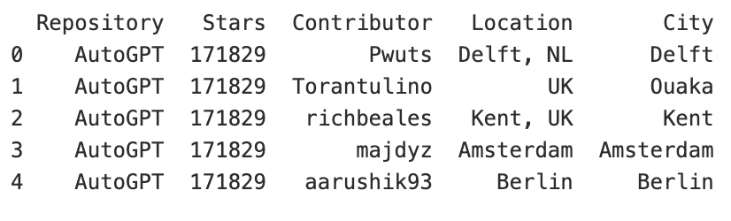
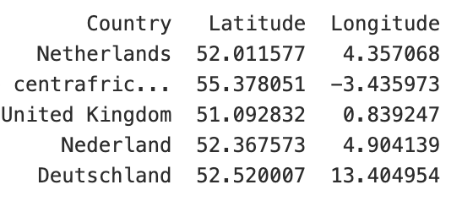
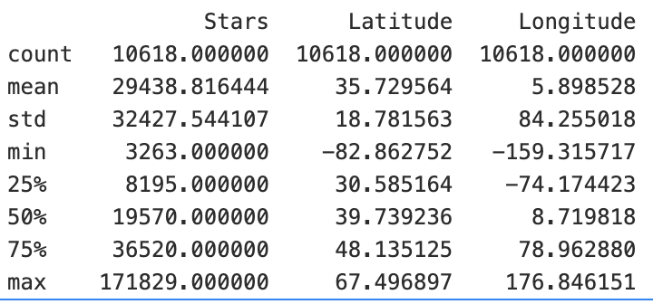
Exploratory Statistical Description
MACS 30112
Location dataset
Winter 25
Final Project

Slide 29
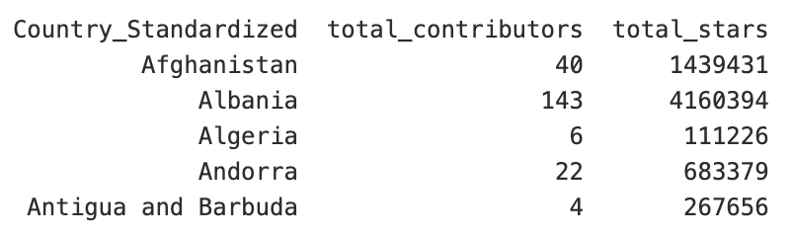
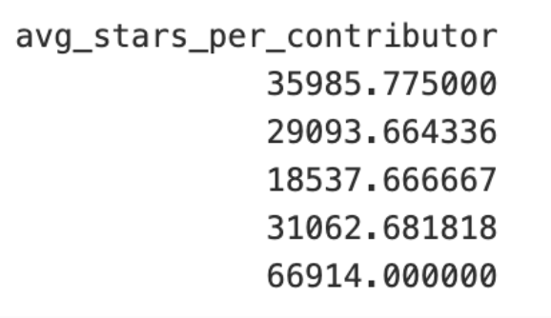
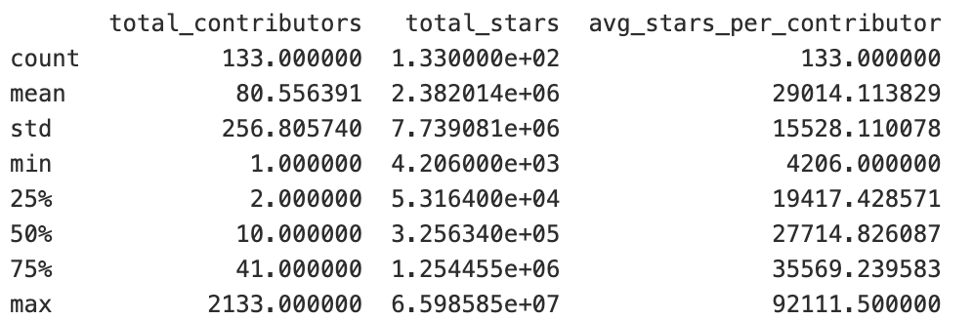
Exploratory Statistical Description
MACS 30112
Country-level dataset
Winter 25
Final Project

Slide 30
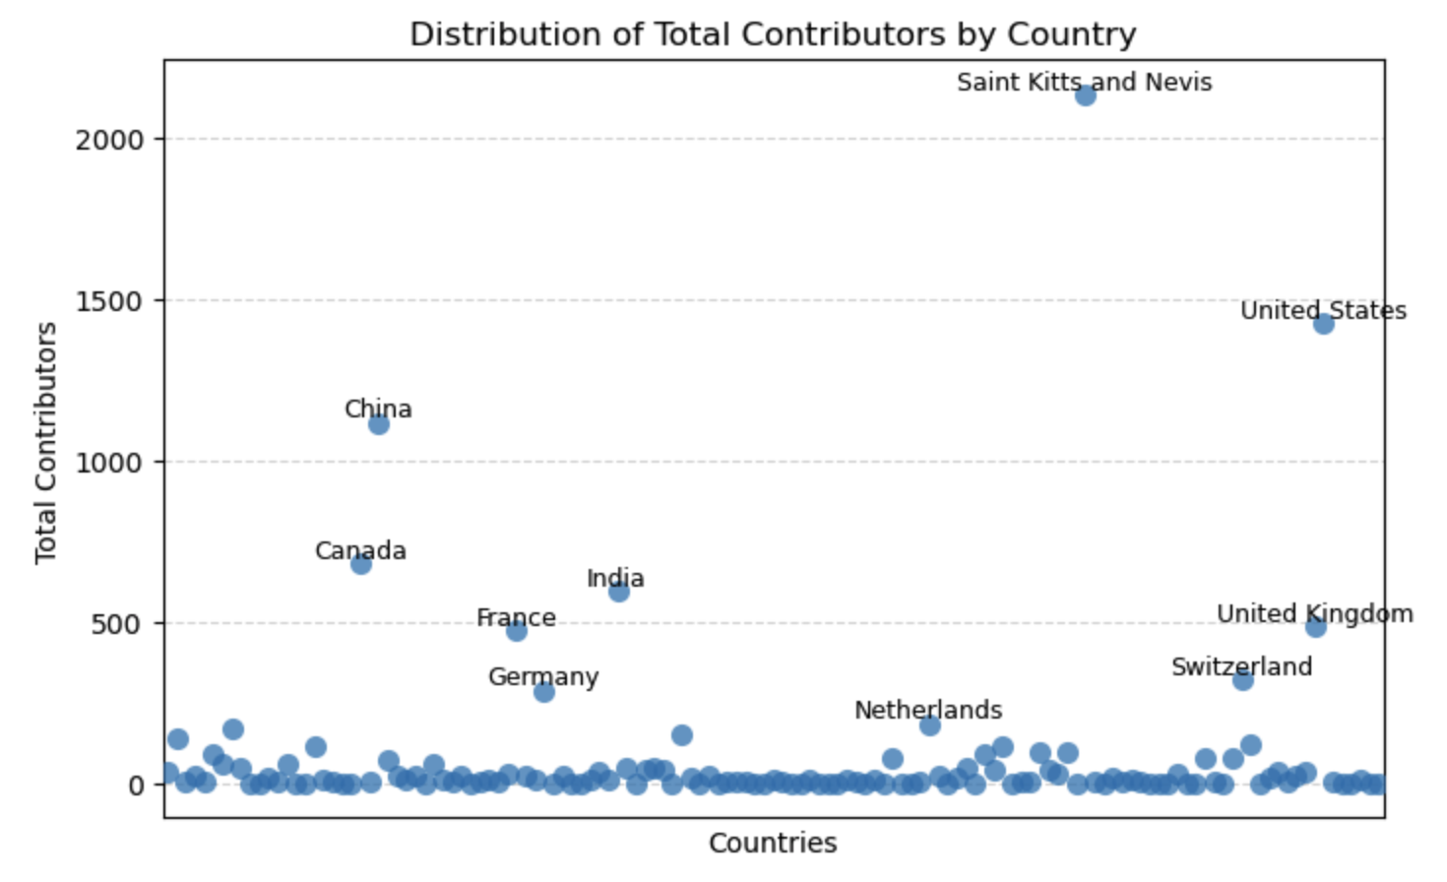
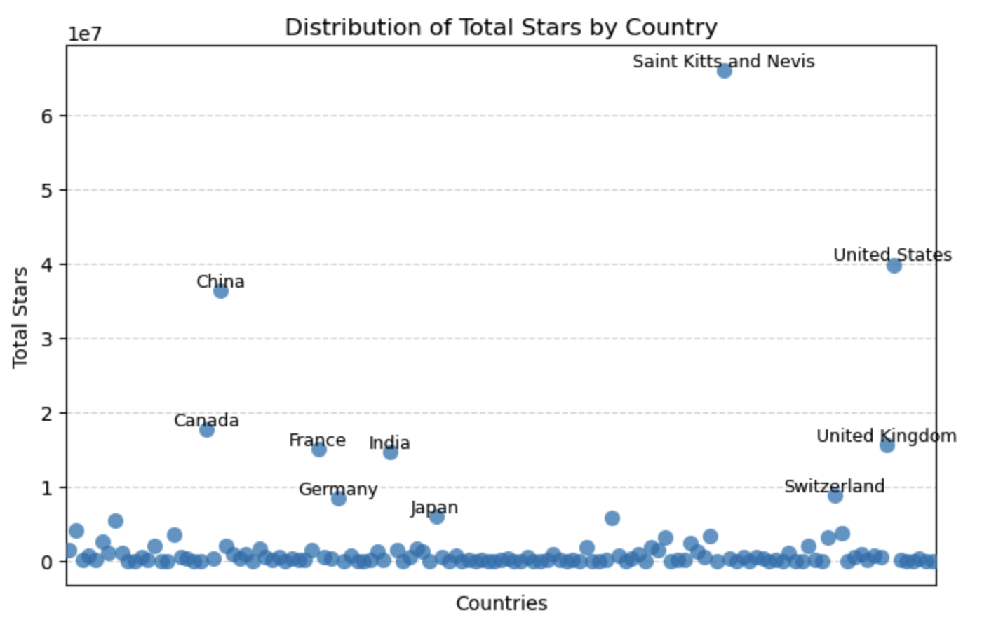
Exploratory Statistical Description
MACS 30112
Country-level dataset
Winter 25
Final Project

Slide 31
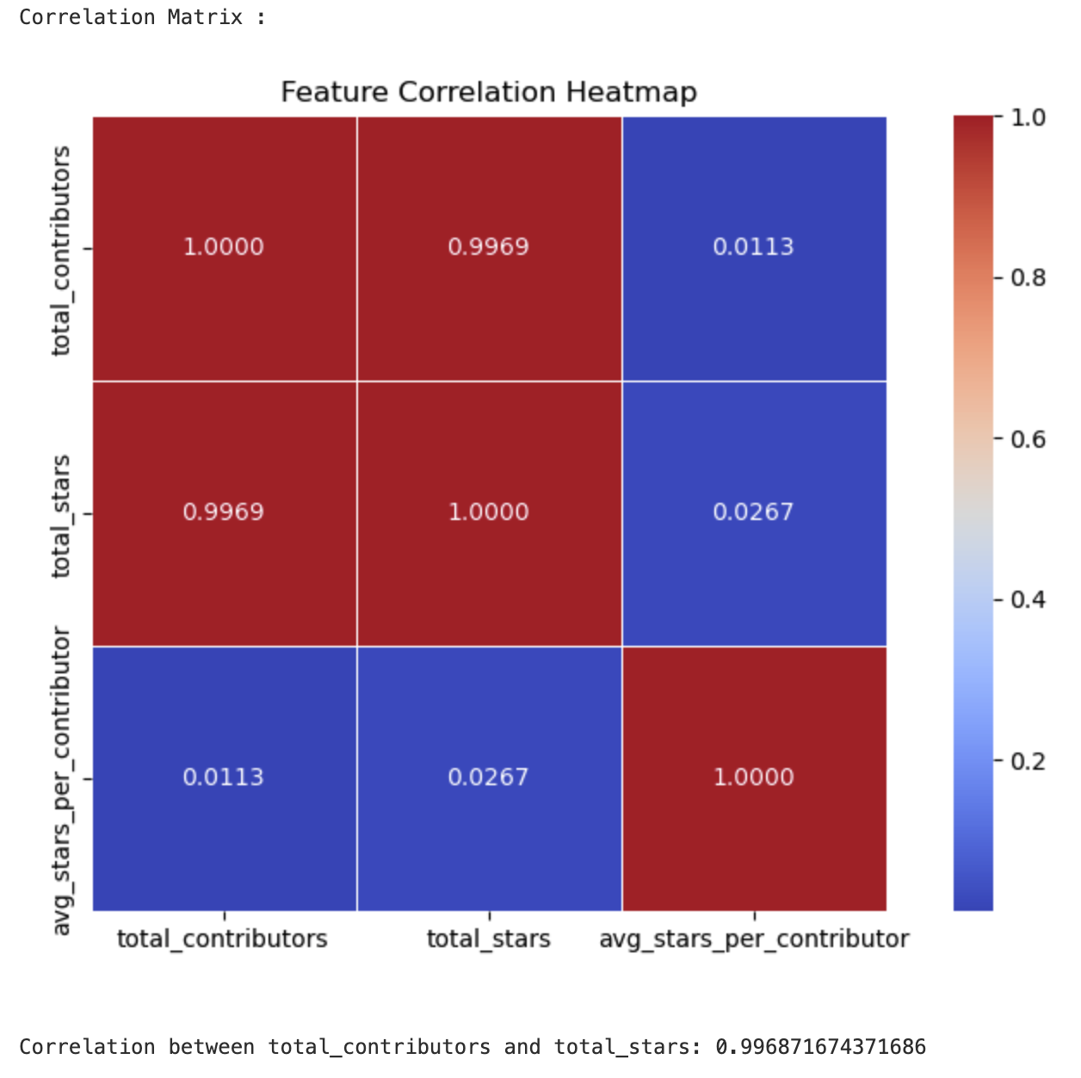
Exploratory Statistical Description
MACS 30112
Country-level dataset
Winter 25
Final Project

Slide 32
Data
MACS 30112
Winter 25
Analysis
Final Project

Slide 33
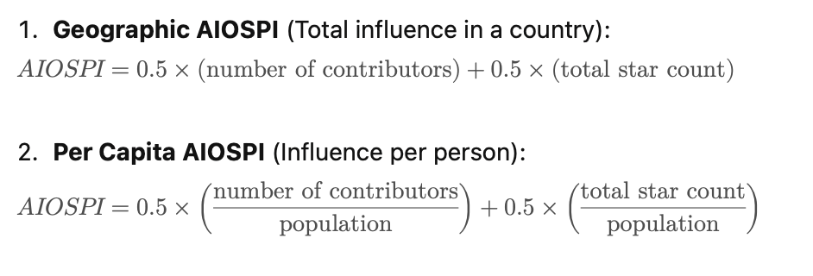
Dependent Variable:
AI Open-Source Participation Index (AIOSPI)
MACS 30112
Winter 25
Final Project

Slide 34
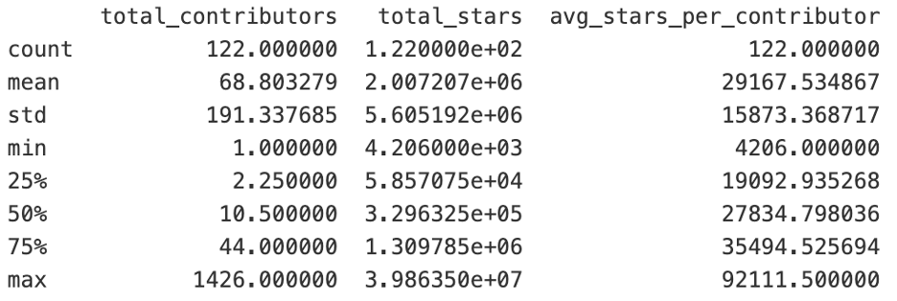
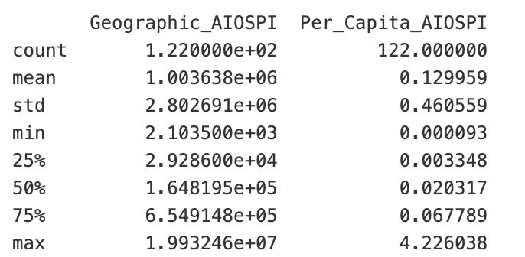
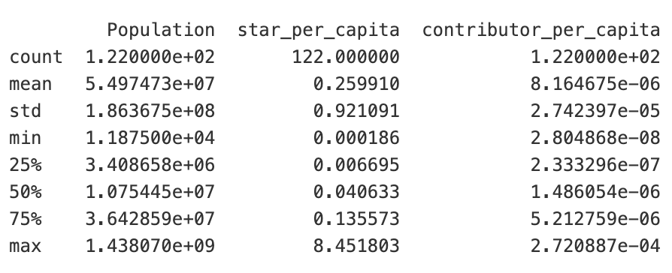
Description of Final Dataset
MACS 30112
Winter 25
Final Project

Slide 35
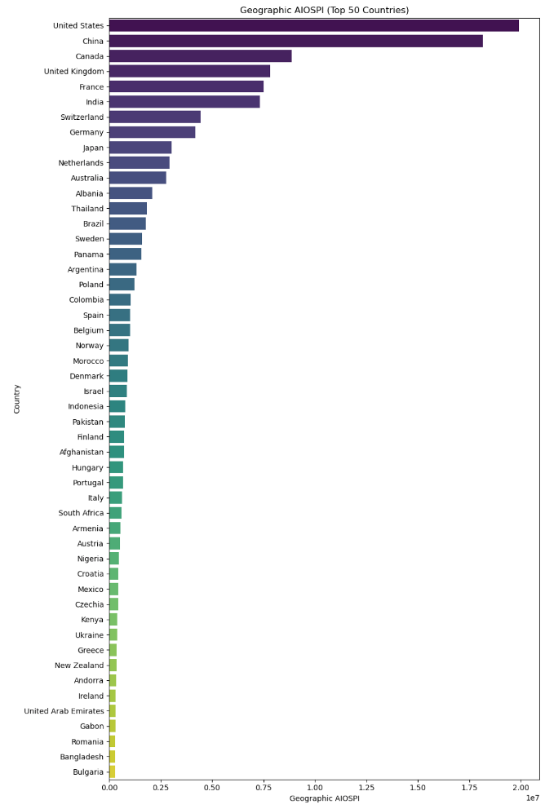
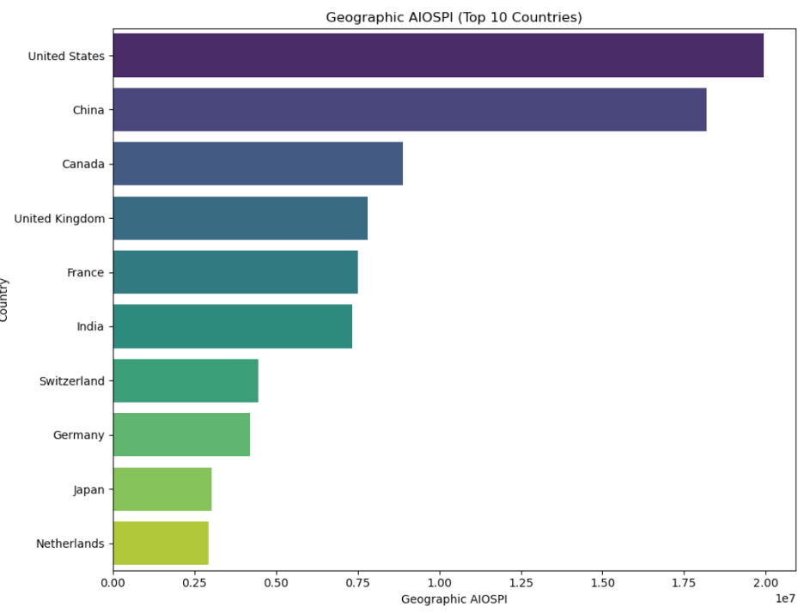
Ranking of Top Countries in Geographic AIOSPI
MACS 30112
Winter 25
Final Project

Slide 36
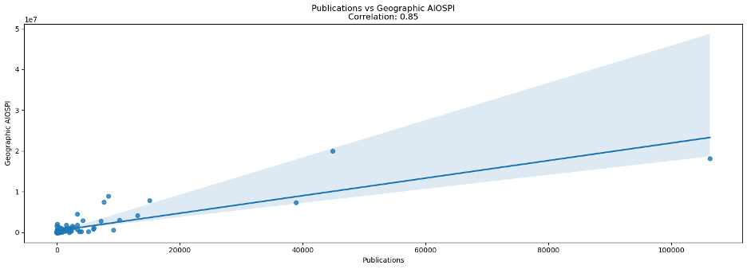
Correlations:
Geographic AIOSPI and AI Publications (Education/Research) had a strong correlation ——0.85
MACS 30112
Winter 25
Final Project

Slide 37
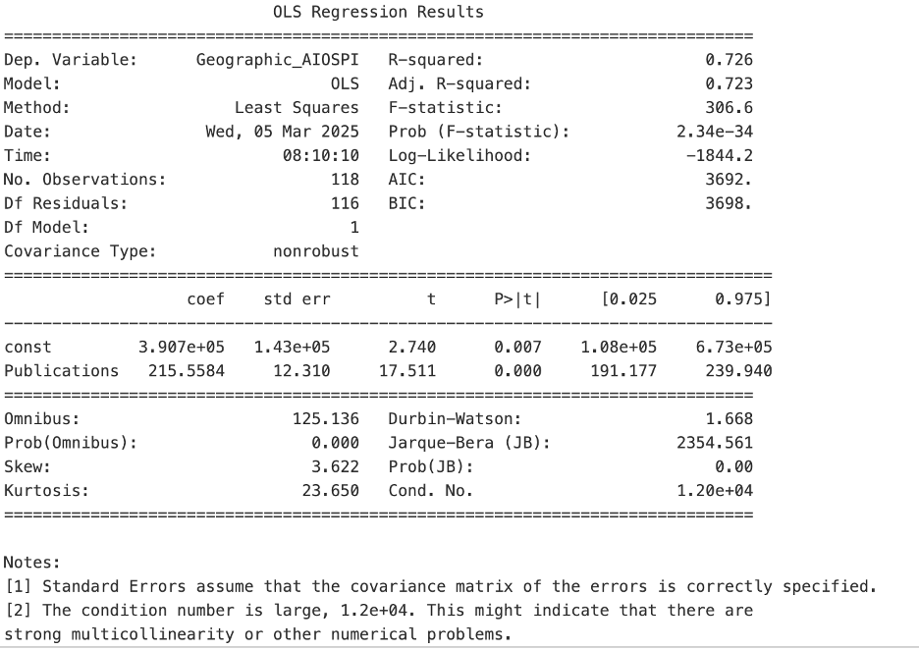
Regression Analysis:
MACS 30112
Our variables are numerical——
Linear regression
the coefficient is 215.56, meaning for every 1 additional AI publication, the AI index would increases by 215.56.
P-value = 0.000, meaning this relationship is highly significant.
R² showing that 72.6% of the variation in Geographic AIOSPI can be explained by the number of AI publications.
Winter 25
Final Project

Slide 38
1. Leading countries:
United States, China, Germany, India, and Japan
2. Leading cities:
San Francisco, Beijing, Seattle, London, New Delhi, Berlin, and Deutschland
MACS 30112
Key Findings:
Winter 25
3. Important indicators:
GDP
high-level research output (AI publications)
4. Global Inequality
Final Project
Notes:
In this project, we analyzed AI open-source participation worldwide by extracting contributors’ geographic locations from GitHub.
We found that the United States, China, Germany, India, and Japan are the leading countries in AI open-source development.
The top cities are here, which are not surprised, these cities cities have more AI companies
Our results suggest that GDP and high-level research output (AI publications) play a key role in explaining these patterns.
However, AI open-source projects have not significantly reduced global inequalities—developed countries still dominate.
Even though In theory, as long as people have internet access, they should be able to access these open-source resources and learn from them.
We believe it indicates underlying inequalities in information technology and will lead to potential gap in the future economic development of related industries
In short, AI open-source activity is strongly linked to national economic and research strength.

Slide 39
Questions Response:
MACS 30112
……Perhaps comparing G77 countries/cities might give important insights into 'emergent' AI contributors……
Great suggestion! We should indeed refine our country/region classification further. Additionally, we are considering incorporating the creation time of each repository to analyze the development speed across different countries. This would make our research even more valuable.
……I’m curious about how you conducted the manual validation for the Google Translate API results—did you randomly sample translations for accuracy checks? ……
We saved the results separately after using the Google Translate API. For the city-level data, which is relatively large, we applied random sampling. For the country-level data, which is relatively smaller, we manually verified each entry.
……Curious on how to standardize city and country names……
We used tools such as pycountry and geocode to match the country and city names in the data with the built-in information packages, thereby standardizing them.
……it would be great to dive deeper into the social science angle—especially looking at global inequality. I’m also curious how this perspective could be explored within a political context, such as technological competition between nations……
Yes~ We considered this approach as well! Initially, we aimed to conduct a comparative analysis of cities, particularly those with similar endowments but different levels of AI development progress. The discussion would explore whether factors such as policies promoting AI development played a role. This remains a feasible research direction.
Winter 25
Final Project

Slide 40
Questions Response:
MACS 30112
5. ……the limitations of using GitHub as a primary data source for AI development……
Thank you for your question. We indeed haven’t verified GitHub’s global usage distribution; we only know that it has a large user base and that previous researchers have used GitHub-related data. Our initial reasoning was that, since we are focusing on participation in open-source projects, GitHub data can reflect certain aspects of this engagement. But you raise a reasonable point—perhaps we should first confirm this assumption to reduce potential bias in our analysis.
6. ……incorporate number of universities in those cities/countries……
Yes, you’re right. .We initially intended to integrate university/research institute data into our dataset but couldn’t find high-quality data sources at the time. Thank you for pointing this out!
7. ……to explore whether government AI policies or funding initiatives influence……
Yes! These are crucial institutional and policy variables. Thank you for your question!
8. ……Very curious about your method of making the interactive map……
We used OpenStreetMaps and Google Maps API to locate each contributors’ locations and return their latitudes and longitudes, with that we use the Folium Map function to generate the interactive map, we also set the function to pop up each contributor’s location and their specific information.
Winter 25
Final Project

Slide 41
Questions Response:
MACS 30112
9. ……did you run your regression without the more extreme values to test it……
Good question! We did not remove the outliers because our research focuses on the global economy rather than being limited to medium-sized economies. We believe that outliers may be a crucial part of the data rather than mere noise. For example, the United States has a significantly higher GDP than other countries, but it is an essential part of the global economic system. Therefore, we chose to retain these data points to ensure the completeness of our analysis. However, to further examine the robustness of our model, we may need to assess whether these outliers have an excessive impact on the results.
10. ……Will you analyze regional disparities within countries? ……Can you track AI talent migration (e.g., where top AI researchers obtained their degrees vs. where they work now).......
We attempted to examine intra-country differences from a city-level perspective. However, further granularity is challenging. On one hand, users rarely specify smaller locations themselves, even though such data does exist. On the other hand, the accuracy of geocoding is sometimes insufficient to achieve the desired level of precision.
11. ……Really interesting project and approach! I'd love to hear more about how you guys figured out the geocoding process: what resources did you use to approach this part of the project?……
Resources we used: OpenStreetMaps, Google Maps, Google clouds. Folium Map. Html.
We think one thing we learnt from this approach is that geocoding really needs a lot of specific information(coordinates), so it is bette to make your functions return as many dataset as possible.
Winter 25
Final Project

Slide 42
Thanks for your listening!
MACS 30112
Winter 25
Final Project
Anqi Wei, Charlotte Li, Baihui Wang

